Slide 1
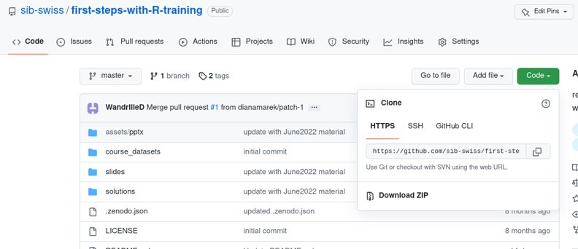

Let's practice - 1
Outside Rstudio : prepare the course data for the exercises
Download the course material from :
https://github.com/sib-swiss/first-steps-with-R-training
Either use git clone OR click Download ZIP
and UNZIP and then move the folder where you want it
Inside Rstudio: project setup
In Rstudio, create a new project set in the folder of the course material you just recovered.

Slide 2
Let's practice - 2
Prepare your first script
Open a script file and save it.
Type or paste the following code
# First steps with R, ex1
w <- 3
h<- 0.5
area <- w*h
area
Look at the script (before running it) can you understand each line? What do you expect it to print to the console?
Run the script and explore Rstudio's feature:
Run the script line-by-line or Run all lines at once by selecting them

Slide 3
Let's practice - 2bis
Look at your project option (Tools > Project Options). If needed, modify them to save your workspace and history and to restore them at startup.
Check that it works:
Close Rstudio
Double-click the .Rproj file
Does the project open? Is your workspace empty?
Check other behaviours:
Close your project
Open your project again from Rstudio

Slide 4
Let's practice - 3
Open a new script and save it
Assign the values 6.7 and 56.3 to variable a and b, respectively
Calculate (2*a)/b+(a*b) and assign the result to variable x. Display the content of
Find out how to compute the square root of variables. Compute the square root of a, of b, and of a/b
Calculate:
the logarithm of x
the logarithm in base 2 of x

Slide 5
Let's practice - 4
Create two vectors:
vector_a, containing the values from −5 to 5
vector_b, from 0 to 1 by increment of 0.1
Calculate the (element-wise) sum, difference and product between the elements of vector_a and vector_b. ​
Calculate the sum of elements in vector_a. ​
Calculate the overall sum of elements in both vector_a and vector_b.​
Identify the smallest and the largest value in vector_a​
Identify the smallest and the largest value among both vector_a and vector_b.​
Compute the overall mean of the values among both vector_a and vector_b.​
Hint: Each task in exercises 1-7 can be performed in a single statement per vector
(the minimum and maximum count as 2 separate tasks)​

Slide 6
Let's practice - 5
Open a new script and save it as "Ex5.R".
In your script, write and execute the commands
library(MASS) # loads the library MASS
data(bacteria) # loads the bacteria data set (from MASS)
Check: You should have a variable named "bacteria" in your Environment.
What are the names of the columns of the bacteria data.frame ?
Use [] to select rows 100 to 119 of the column “ap” .
Use $ to get the column "week" and check how many 0 values it has.
Optional : using a comparison operator and [], select the rows which correspond to a “placebo” treatment (in the “trt” column).

Slide 7
Let's practice – 6a
A dataset from mouse experiments at 18 weeks is available in the file mice_data.csv in the course_dataset folder (courtesy of F. Schutz and F. Preitner). Let's explore the dataset to see what it contains.
Open a new script file in R studio, comment it and save it.
Have look at the csv file in R studio's file explorer. What do you need to check in order to be able to read in the file correctly?
Read the file into R, assign its content to object "mice_data". Examine the object.
How many observations and variables does the dataset have?
What is the structure of the dataset? What are the names and classes of the variables?

Slide 8
Let's practice – 6b
Continue from the mouse dataset used previously.
Use the following code if you do not have the dataframe already loaded
mice_data = read.csv("course_dataset/mice_data.csv")
Which variables appear to be categorical? Convert them to factors.
Get the summary statistics of "mice_data"
Use the function table() to compute the number of observations in different mouse groups.
How many mice are included of each genotype (WT, KO)?
How many mice are included per diet (HFD, CHOW)?
Make a 2x2 table by genotype and diet crossed.

Slide 9
Let's practice – 6c
Continue from the mouse dataset used previously.
Use the following code if you do not have the dataframe already loaded
mice_data = read.csv("course_dataset/mice_data.csv")
Subsets
Isolate the observations for the mice on high fat diet (HFD) using subset().
Compute the average weights of the subset.
Do the same for the mice on regular chow diet (CHOW).
Export the data of each subgroup to a csv file.
Look at the results from the two previous exercises. What does this initial exploration of the data suggest about mouse weights?
Optional: Compute the means and standard deviations for WT and KO mouse weights using tapply(). Then do the same for CHOW and HFD groups.

